Slide 1
Section L
Respiration and energy
Guodong Yang
Biochemistry and Molecular Biology, College of Life Sciences
gdyang@sdau.edu.cn
13854808762
Notes:
respiration 英 [ˌrespəˈreɪʃn] 美 [ˌrɛspəˈreʃən] n. 呼吸，一次呼吸; （植物的） 呼吸; 一息
energy 英 [ˈenədʒi] 美 [ˈenərdʒi]
n. 精力; 活力; [物] 能量; 精神

Slide 2
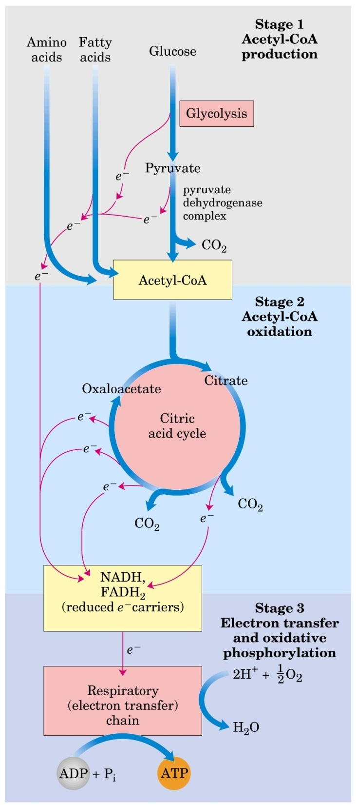
Notes:
一、生物体需要能量，能量运动的形式是电子的运动、能量的定量
1 生物体需要能量，能量运动的形式是电子的运动
2.3. 能量的定量：G
4. 能量的通货是ATP
5. 能量的另一种计算方法 E(适用于氧化还原反应）
6. 脱氢酶的辅酶：电子的收集
二、电子传递链和ATP的产生
7,8,9电子传递链的组成
10,11,12 电子传递链偶联ATP的产生
本章解决两个问题：1.生命需要能量，能量能不能定量？如何定量？
2.产生ATP的关键环节，电子传递链？
2020.11.21 生物使用能量：两个方面：1. 能量在整个生物圈的流动的形式是电子的流动
2. 能量的转化时发生在细胞内的，称为细胞呼吸（cellular respiration）

Slide 3
1. Cells need energy to do all their work
To generate and maintain its highly ordered structure (biosynthesis of macromolecules).
To generate all kinds of movement.
To generate concentration and electrical gradients across cell membranes.
To maintain a body temperature.
To generate light in some animals.

Slide 4
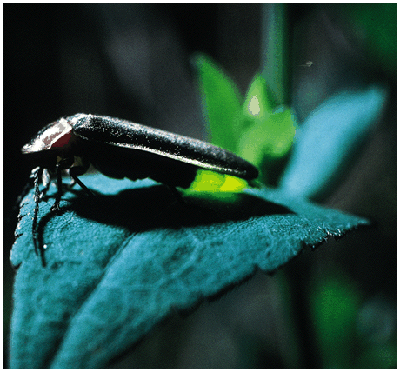
Firefly
Notes:
萤火虫（英文：Firefly）又名夜光、景天、如熠燿、夜照、流萤、宵烛、耀夜等，属鞘翅目萤科，是一种小型甲虫，因其尾部能发出荧光，故名为萤火虫。这种尾部能发光的昆虫，约有近2000种，我国较常见的有黑萤、姬红萤、窗胸萤等几种。
发光的生物学意义：
成虫利用物种特有的闪光信号来定位并吸引异性，借此完成求偶交配及繁殖的使命，少数萤火虫成虫利用闪光信号进行捕食，还有一种作用是作为警戒信号，即当萤火虫受到刺激时会发出亮光。[
问题，发光的是雄虫吗？还是都可发光？
雄虫触角较长，有11节，呈扁平丝或锯齿状；腹部可见腹板6~7节，末端有发光器，可发出荧光；雄虫大多有翅。雌虫无翅，身体比雄虫大，不能飞翔，但荧光比雄虫亮。
萤火虫是一种在夜间能发光的动物，人们曾实验，在雌虫发光结束时，用人工发出2秒钟的闪光，雄虫也会被引诱过来．另有一种萤火虫，雌虫能以准确的时间间隔，发出“亮 一 灭，亮 一 灭”的信号来，雄虫收到用灯语表达的“悄悄话”后，立刻发出“亮 一 灭，亮 一 灭”的灯语作为回答．信息一经沟通，它们便飞到一起共度良宵，所以雌萤火虫发光的目的是吸引同种异性前来交配，但题干中的雌虫能准确地模仿另一种萤火虫的信号吸引那种萤火虫的雄性个体前来，雌的这样做了，雄的就把它认作为情伴并向它靠近．雄的在结束其发光后，若用实验办法人工发出二秒钟的闪光，则雄的也能被引诱．这种行为的意义可能是诱骗不同种异性以取食

Slide 5
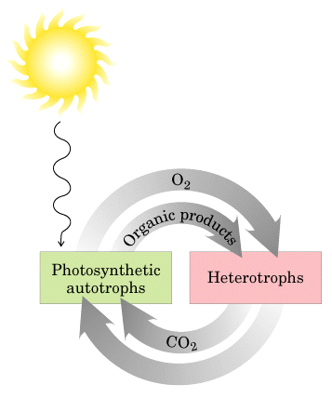
e
e
Notes:
autotroph 英 [ˈɔ:tətrəʊf] 美 [ˈɔ:tətroʊf] n. 自养生物，靠无机物质生存的生物; 真核有植物，原核有蓝藻
heterotroph 英 [ˈhetərətrəʊf] 美 [ˈhetərətroʊf] n. 异养生物

Slide 6
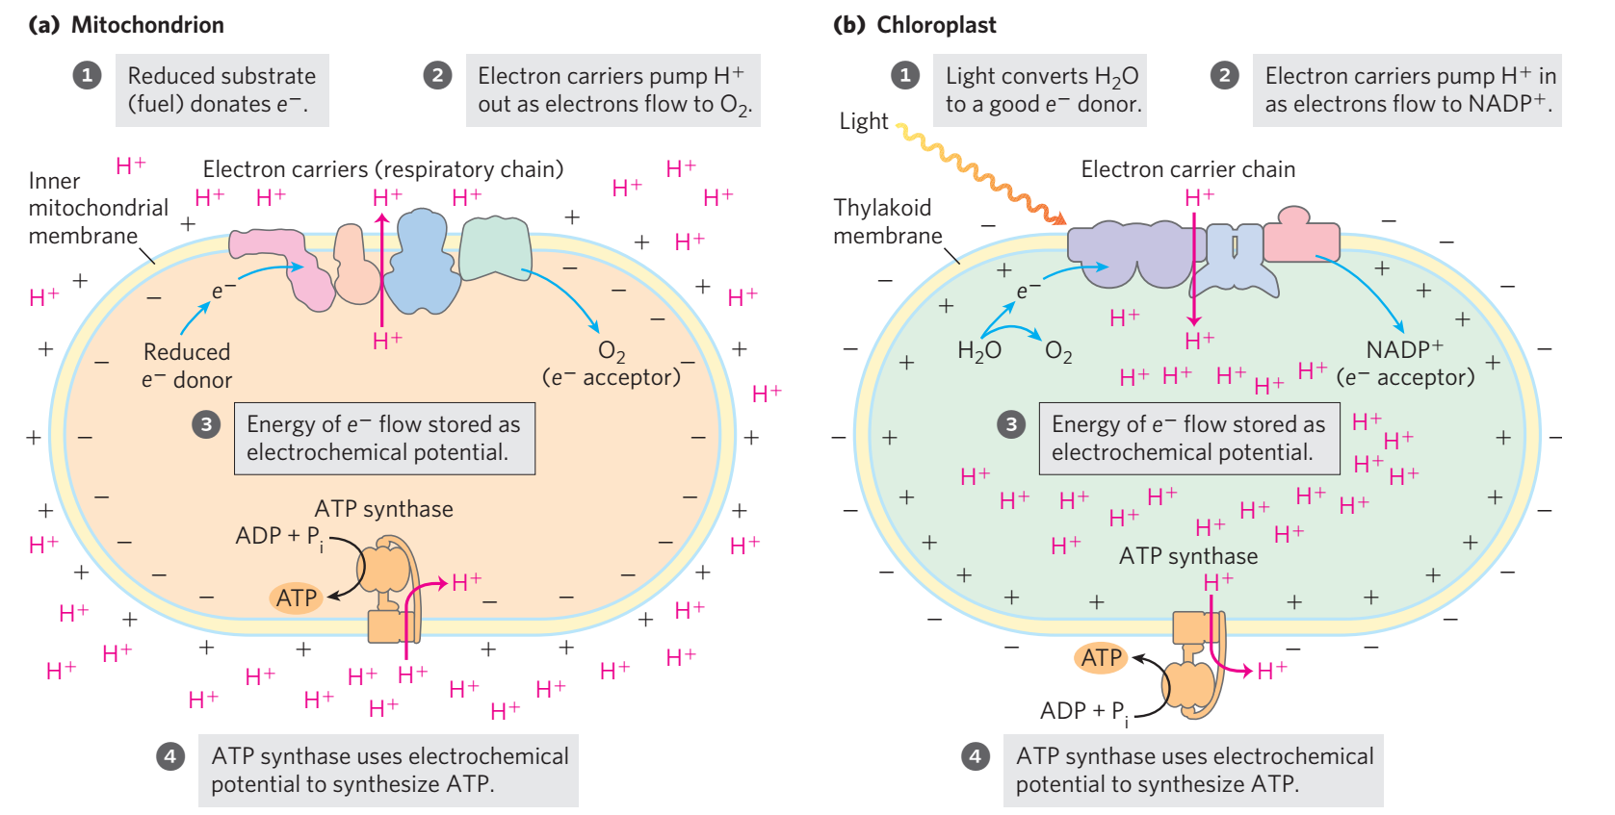

Slide 8
Notes:
本章解决两个问题：1.生命需要能量，能量能不能定量？如何定量？
2.产生ATP的关键环节，电子传递链？

Slide 9
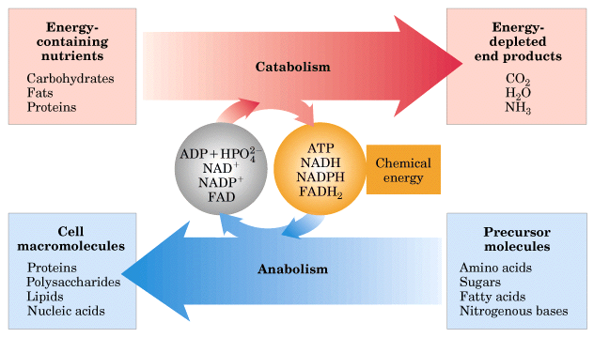
metabolism
Notes:
异养生物的脱氢氧化过程
metabolism 英 [məˈtæbəlɪzəm] 美 [mɪˈtæbəˌlɪzəm] n. 新陈代谢; 代谢作用
catabolism 英 [kə'tæbəlɪzəm] 美 [kə'tæbəlɪzəm] n. 异化作用，分解代谢; 陈谢
anabolism 英 [ə'nabəˌlɪzəm] 美 [ə'nabəˌlɪzəm] n. 合成代谢

Slide 10
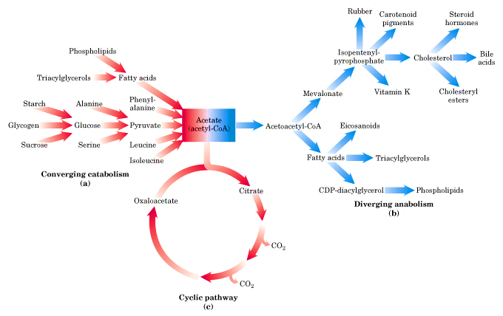

Slide 11
Bioenergetics (生物能学）: the quantitative study of energy transductions in living cells and the chemical nature underlying these processes.

Slide 12
2. Cells have to use chemical energy to do all their work
Antoine Lavoisier`s（1743－1794） insight on animal respiration in the 18th century: it is nothing but a slow combustion of carbon and hydrogen (the same nature as a lighting candle).
Living cells are generally held at constant temperature and pressure: chemical energy (free energy) has to be used by living organisms, no thermal energy, neither mechanical energy is available to do work in cells.
Notes:
combustion 英 [kəmˈbʌstʃən] 美 [kəmˈbʌstʃən]
n. 燃烧，烧毁; 氧化; 骚动
文艺复兴(14到17世纪的西欧思想解放文化运动) - 百度百科
安托万-洛朗·德·拉瓦锡（法语：Antoine-Laurent de Lavoisier，1743年8月26日－1794年5月8日），法国贵族，著名化学家、生物学家，被广泛认为是人类历史上最伟大的化学家。拉瓦锡被后世尊称为"化学之父"（father of chemistry）、"现代化学之父"（father of modern chemistry）。
他使化学从定性转为定量，给出了氧与氢的命名，并且预测了硅的存在。他帮助建立了公制。拉瓦锡提出了“元素”的定义，按照这定义，于1789年发表第一个现代化学元素列表，列出33种元素，其中包括光与热和一些当时被认为是元素的化合物。拉瓦锡的贡献促使18世纪的化学更加物理及数学化。他提出规范的化学命名法，撰写了第一部真正现代化学教科书《化学基本论述》（Traité Élémentaire de Chimie）。他倡导并改进定量分析方法并用其验证了质量守恒定律。他创立氧化说以解释燃烧等实验现象，指出动物的呼吸实质上是缓慢氧化。这些划时代贡献使得他成为历史上最伟大的化学家。^{[1]}
拉瓦锡曾任税务官，因此他有充足的资金进行科学研究。不幸在法国大革命中被送上断头台而死。法国著名数学家拉格朗日痛心地说：“他们可以一眨眼就把他的头砍下来，但他那样的头脑一百年也再长不出一个来了。”
中世纪（Middle Ages）从公元5世纪持续到公元15世纪，是欧洲历史三大传统划分的一个中间时期。中世纪始于西罗马帝国灭亡（公元476年），
最终融入文艺复兴和探索时代（地理大发现）中。 ^{[1]} 另有说法认为中世纪结束于东罗马帝国灭亡
工业革命（The Industrial Revolution ）开始于十八世纪六十年代，通常认为它发源于英格兰中部地区，是指资本主义工业化的早期历程，

Slide 13
Biological energy transformation obey the two basic laws of thermodynamics revealed by physicists and chemists in the 19th century: energy can neither be created nor be destroyed (but conserved); energy conversion is never 100% efficient (some will always be wasted in increasing the disorder or “entropy” of the universe).
The free energy concept of thermodynamic is more important to biochemists than to chemists (who can always increase the temperature and pressure to make a reaction to occur!).
Notes:
entropy 英 [ˈentrəpi] 美 [ˈɛntrəpi] n. 熵，平均信息量; 负熵
质量守恒定律是俄国科学家罗蒙诺索夫于1756年最早发现的。拉瓦锡通过大量的定量试验，发现了在化学反应中，参加反应的各物质的质量总和等于反应后生成各物质的质量总和。这个规律就叫做质量守恒定律(Law of conservation of mass)。也称物质不灭定律。它是自然界普遍存在的基本定律之一。

Slide 14
3. Application of the free energy (G) concept to biochemical reactions
Free energy (G): the amount of energy available to do work during a reaction at a constant temperature and pressure; change, not absolute value can be measured.
Free energy change (ΔG): The free energy difference between the products and the reactants.
Notes:
reactant 英 [riˈæktənt] 美 [riˈæktənt] n. 反应物

Slide 15
Gibbs (Josiah W. Gibbs)observation: under constant temperature and pressure, all systems change in such a way that free energy is minimized (products should have less free energy than reactants for a reaction to occur spontaneously, i.e., ΔG has a negative value ).
Notes:
约西亚·威拉德·吉布斯（Josiah Willard Gibbs，1839年（己亥年）2月11日－1903年（癸卯年）4月28日），美国物理化学家、数学物理学家。

Slide 16
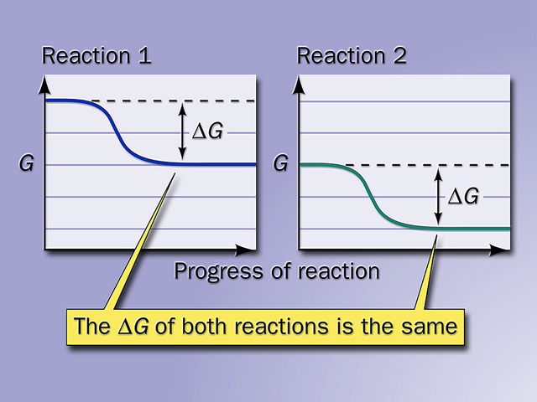

Slide 17
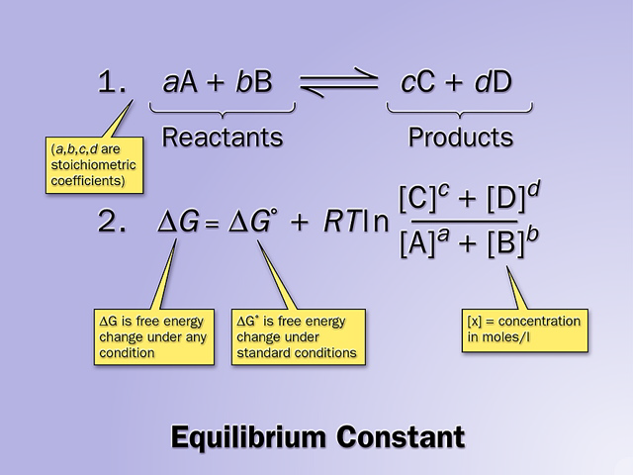


Slide 18
Spontaneity has nothing to do with rate!
Standard free energy change in biochemistry (ΔG'º): value of the change in free energy under conditions of 298 K (25ºC), 1 atm pressure, pH 7.0 (chemists use pH 0, i.e., the concentration of H⁺ they use is 1M, not 10⁻⁷ M as biochemists use here) and initial concentrations of 1 M for all reactants and products (except H⁺).
Notes:
spontaneity 英 [ˌspɒntəˈneɪəti] 美 [ˌspɑ:ntəˈneɪəti] n. 自发性，自然发生; 自发行为[行动]

Slide 19
The actual free energy chang (ΔG )depends on ΔG'º, temperature, ratio of product and reactant concentrations (Q):
ΔG = ΔG'º + RT ln Q
Enzymes only speed up thermodynamically favorable reactions (having a negative ΔG) !

Slide 20
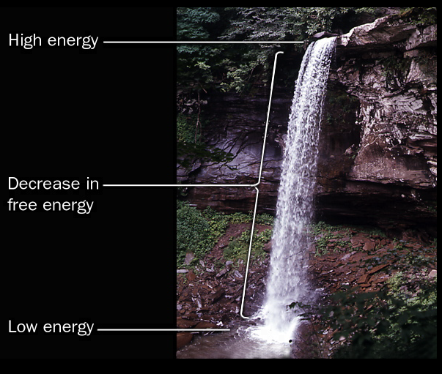
Notes:
此图用来说明自由能总量不可知，而自由能变可测量。

Slide 21
4. ATP is the universal currency for biological energy
This was first perceived by Fritz Lipmann and Herman Kalckar in 1941 when studying glycolysis.
Hydrolysis of the two phosphoanhydride (磷酸酐键) bonds in ATP generate more stable products releasing large amount of free energy (ΔG'º is -30.5 kJ/mol; ΔG in cells is -50 to -65 kJ/mol).
Notes:
生命、细胞利用化学能，如何利用？有机物质氧化释放的化学能转变成了什么形式？可以举例：肌肉运动，是否要等葡萄糖糖酵解、TCA释放能量再做工，还是有一种更快捷的利用方式?
以能量的形式来介绍ATP，能量的通用形式、能量普遍形式
ATP ΔG 为什么这么大 是标准的两倍？因为温度不同，有效浓度（浓度只会影响速率吧？）pH的差异？

Slide 22
The ATP molecule is kinetically stable at pH 7 (i.e., it has a high activation energy, ΔG‡ for hydrolysis) and enzyme catalysis is needed for its hydrolysis.
ATP is not a long-term storage form of free energy in living cells, being consumed within a minute following its formation (phosphocreatine, 磷酸肌酸, act as a energy storage form for longer term).
A resting human consumes about 40 kg of ATP in 24 hours!
Notes:
本词条由“科普中国”百科科学词条编写与应用工作项目 审核 。
磷酸肌酸是在肌肉或其他兴奋性组织（如脑和神经）中的一种高能磷酸化合物，是高能磷酸基的暂时贮存形式。磷酸肌酸水解时，每摩尔化合物释放10.3千卡的自由能，比ATP释放的能量（每摩尔7.3千卡）多些。磷酸肌酸能在肌酸激酶的催化下，将其磷酸基转移到ADP分子中。当一些ATP用于肌肉收缩，就会产生ADP。这时，通过肌酸激酶的作用，磷酸肌酸很快供给ADP以磷酸基，从而恢复正常的ATP高水平。由于肌肉细胞的磷酸肌酸含量是其ATP含量的3～4倍，前者可贮存供短期活动用的、足够的磷酸基。在活动后的恢复期中，积累的肌酸又可被ATP磷酸化，重新生成磷酸肌酸，这是同一个酶催化的逆反应。因为细胞中没有其他合成和分解磷酸肌酸的代谢途径，此化合物很适合完成这种暂时贮存的功能。在许多无脊椎动物中，磷酸精氨酸代替磷酸肌酸为能的贮存形式。可用人的短跑为例说明磷酸肌酸的功能。肌肉中磷酸肌酸的含量为17微摩尔/克，全速短跑可消耗磷酸肌酸13微摩尔/克，故它仅可作为最初4秒钟的能量来源，但它可提供时间来调节糖酵解酶的活性，使肌肉通过酵解得到能量。

Slide 23
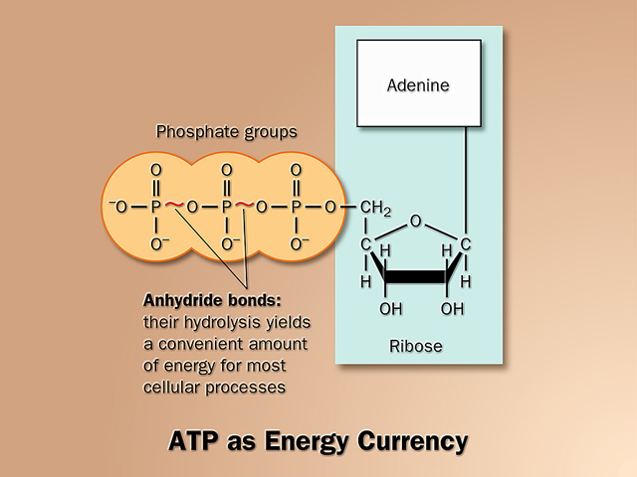
Notes:
anhydride英[æn'haɪˌdraɪd]美[æn'haɪˌdraɪd]
n.酐

Slide 24
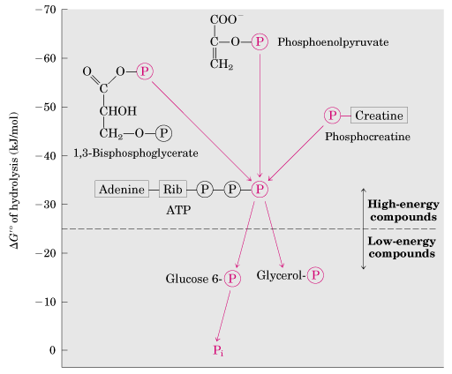
ATP has an intermediate phosphoryl group transfer potential.
Notes:
这个图比喻成水利发电来讲解，水自高向低，势能下降 转化为ATP

Slide 25
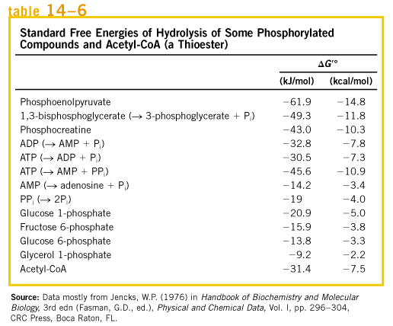
Notes:
phosphocreatine 英 [fɒsfəʊ'kri:əti:n] 美 [ˌfɒsfoʊ'kri:əˌti:n] n. 磷酸肌酸
phosphoglycerate 英 [fɒsfə'glɪsəreɪt] 美 [fɒsfə'glɪsəreɪt] n. 磷酸甘油酸盐[酯

Slide 26
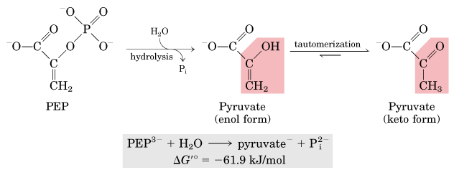

Slide 27
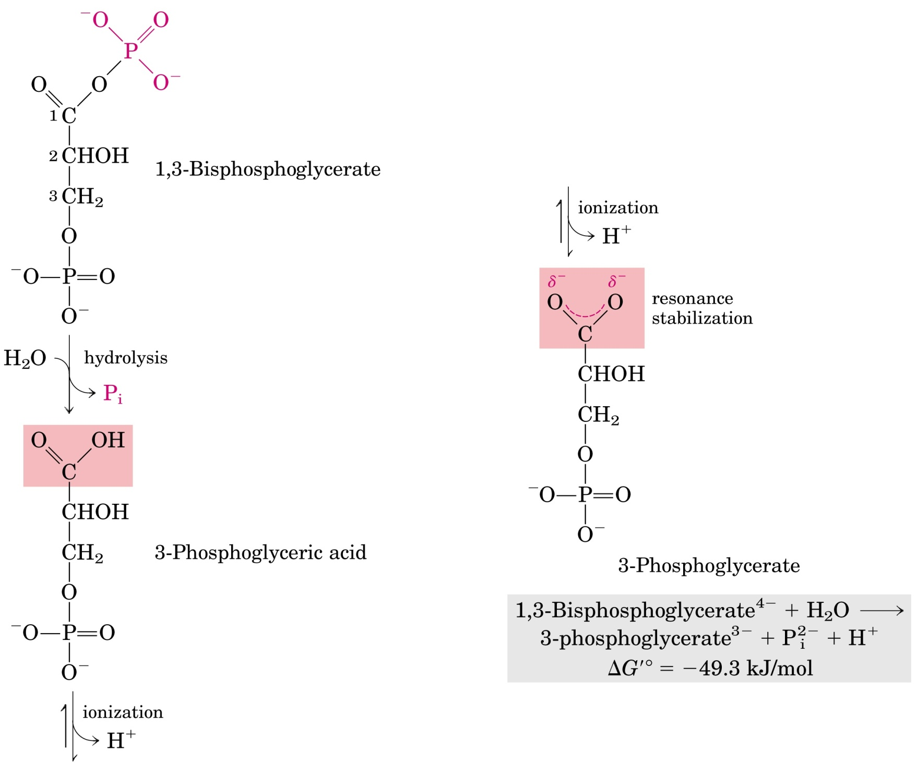

Slide 28
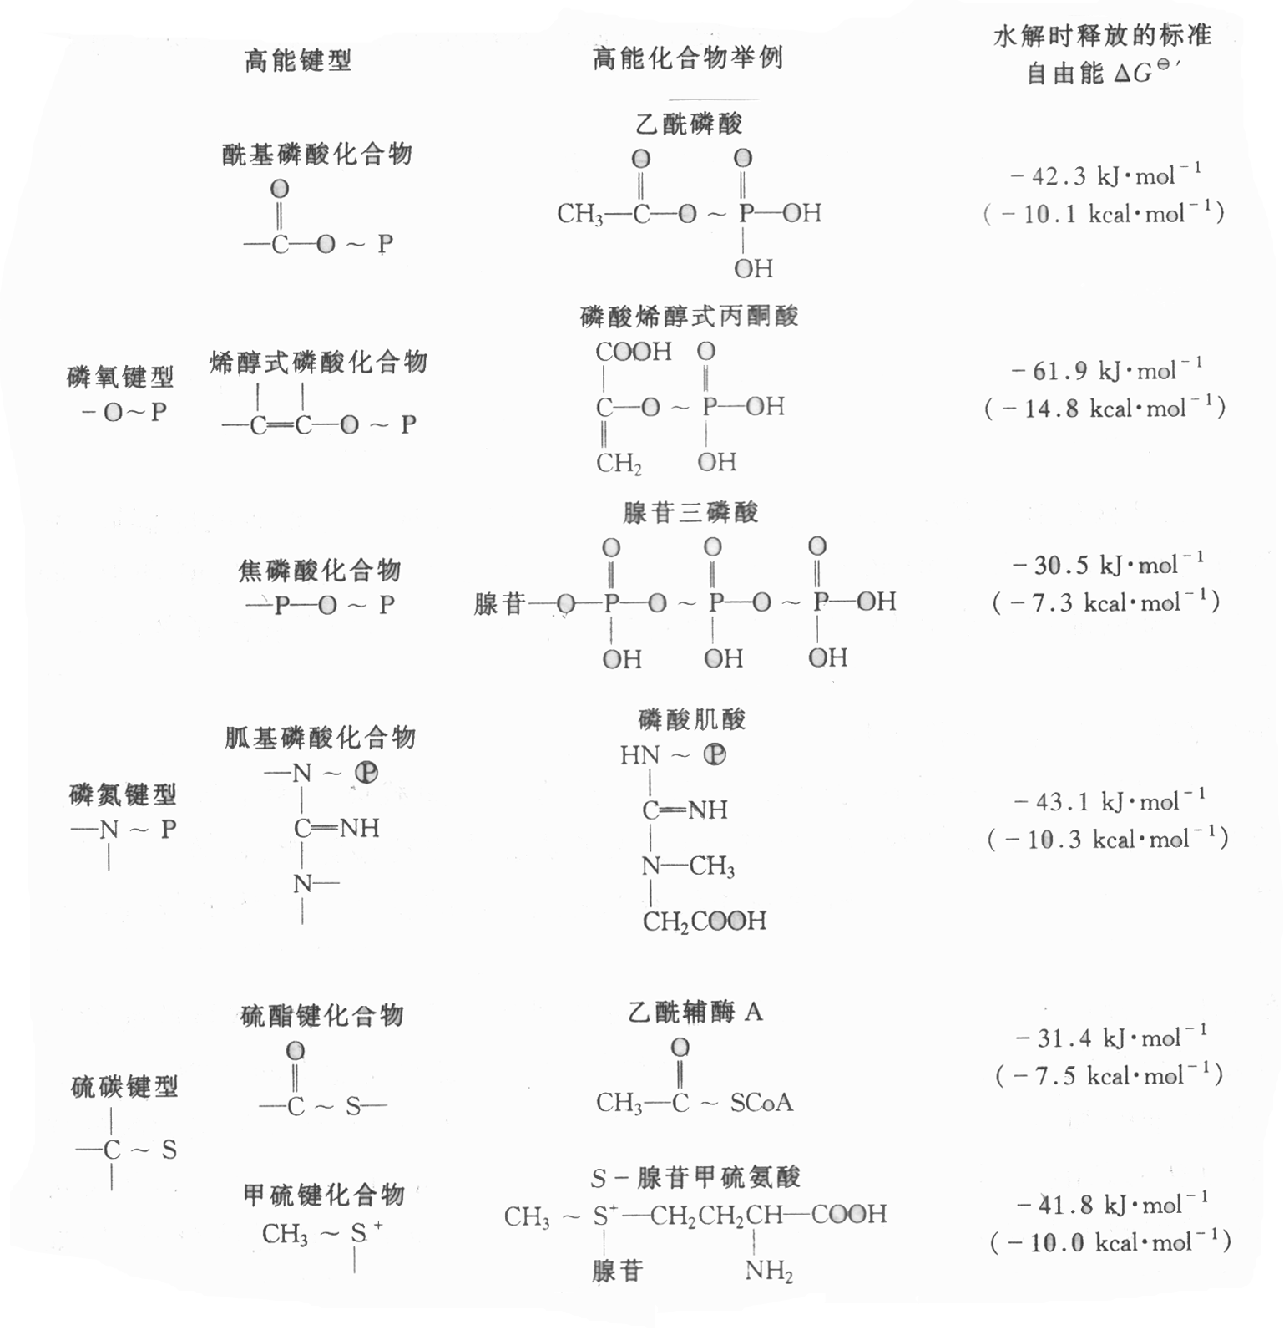
高能化合物类型

Slide 29
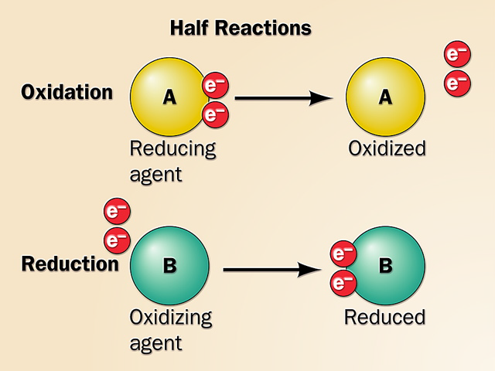
5. Electron transfer via redox reactions generates biological energy

Slide 30
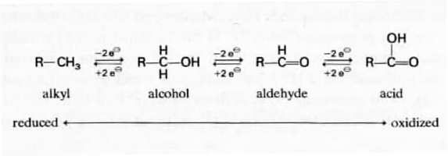
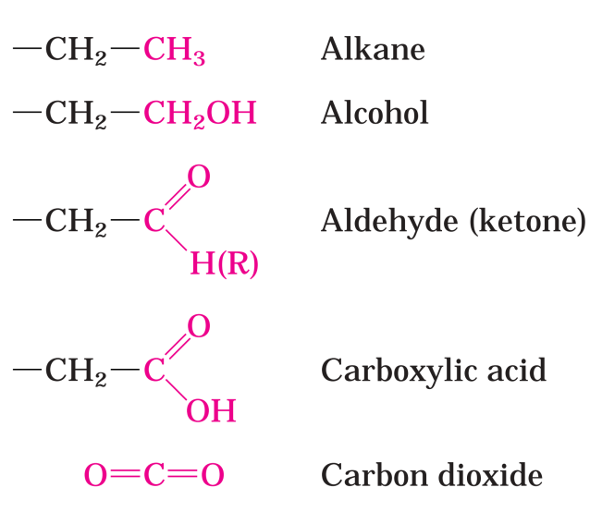
Carbons have various oxidation states, with hydrocarbon being the most reduced and CO₂ being the most oxidized.
Notes:
hydrocarbon英 [ˌhaɪdrəˈkɑ:bən] 美 [ˌhaɪdrəˈkɑ:rbən]
n. <化>碳氢化合物，烃
alkyl
[英] ['ælkɪl][美] ['ælkɪl]
n.烷基，烃基；
adj.烷基的，烃基的；

Slide 31
When electrons flow from a low affinity carrier (reductant) to a high affinity carrier (oxidant), either in an electric battery or in a living cell, energy is released and work can be done.
Oxidation of energy-rich biological fuels often means dehydrogenation (catalyzed by dehydrogenases, 脱氢酶) from carbons having various oxidation states.
In the living cells, electrons are transferred directly as electrons (between metal ions), as hydrogen atoms (H⁺ + e⁻), or as a hydride ion (:H⁻ or H⁺ + 2e⁻).
Notes:
hydride英 ['haɪdraɪd] 美 ['haɪdraɪd] n.氢化物
hydride ion英 [ˈhaidraid ˈaɪən] 美 [ˈhaɪˌdraɪd ˈaɪən] [词典]氢阴离子，带一对电子的质子
脱氢酶脱氢是否可以理解为电子以hydrogen atom的形式传递。
氢负离子
编辑 锁定
氢负离子也称负氢离子（H－），又称为氢化离子，直到最近它才被纳入等离子体物理学的范畴。这种状态的氢，其原子上多带了一个电子，因而带负电，成为负离子。在地球表面常温常压的条件下，H－极不稳定，主要存在于实验室里的等离子体和各种星体（包括太阳）的内部，其寿命只有几毫微秒

Slide 32
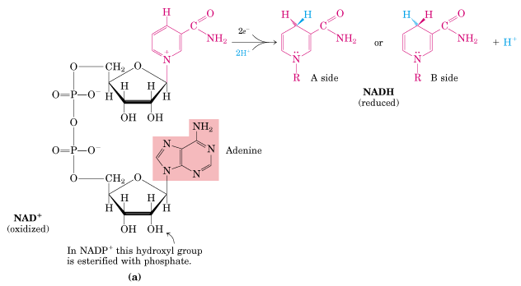
Nicotinamide is derived From niacin(B5)
Notes:
nicotinamide
英 [nɪkə'tɪnəmaɪd] 美 [ˌnɪkəˌtɪnəˌmaɪd]
n.烟碱； 维生素PP； 维生素B5

Slide 33
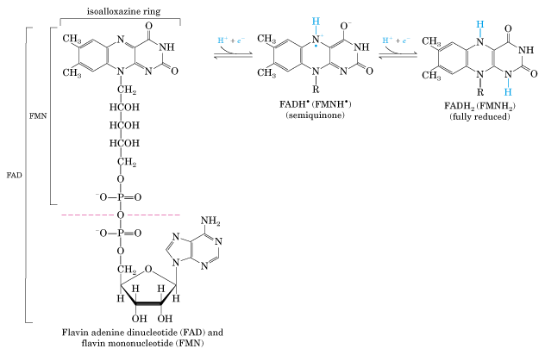
FMN (Flavin
MonoNucleotide)
FAD (Flavin Adenine
Dinucleotide)

Slide 34
The affinity for electrons of a compound (in its oxidized form) is indicated by its reduction potential (E).
Standard reduction potential (E'º) of each oxidant (a constant) is measured by connecting a half-cell having the oxidized and reduced species of the redox pair each at 1 M, or 1 atm for gases, pH 7 to a reference half-cell having 1 M H⁺ and 1 atm H₂, whose E' º is arbitrarily assigned as 0.00 V.
A positive value of E'º indicates a tendency to acquire electron from the reference half cell (with 1M H⁺/1atm H₂).
Notes:
reduction potential 英 [riˈdʌkʃən pəˈtenʃəl] 美 [rɪˈdʌkʃən pəˈtɛnʃəl]
[词典] 还原电势

Slide 35
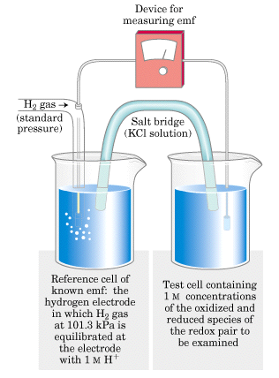
The standard reduction
potential (E'º) of a
conjugate redox pair
is measured by
connecting the sample
half cell to the H⁺/H₂
reference half cell.

Slide 36
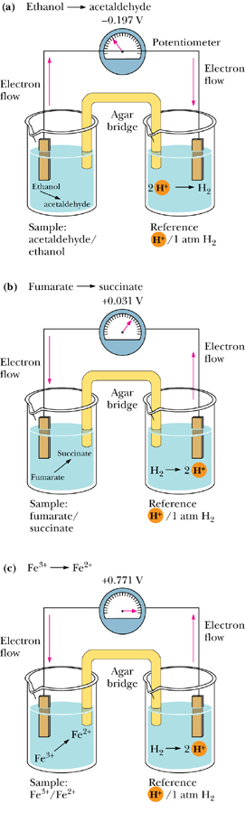
Notes:
acetaldehyde
n.乙醛

Slide 39
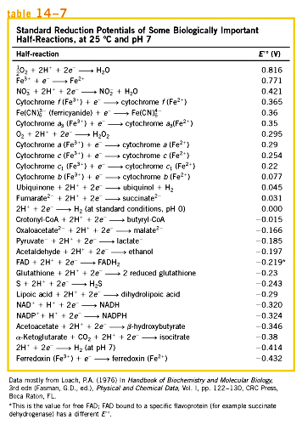
Notes:
ferredoxin英 [fe'redɒksɪn] 美 [ˌferɪ'dɒksɪn] n.铁氧化还原蛋白

Slide 40
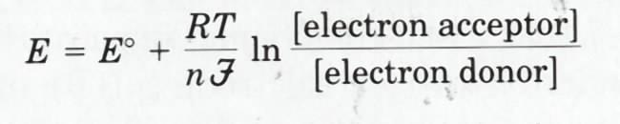
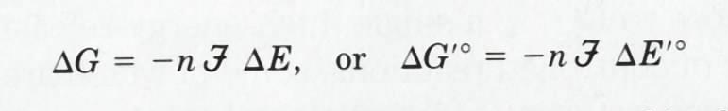
The actual reduction potential (E) depends on , electrons transferred per molecule, temperature, ratio of [electron acceptor]/[electron donor]:
ΔG'º of a redox reaction can be calculated from the ΔE'º of the two redox pairs:

Slide 41
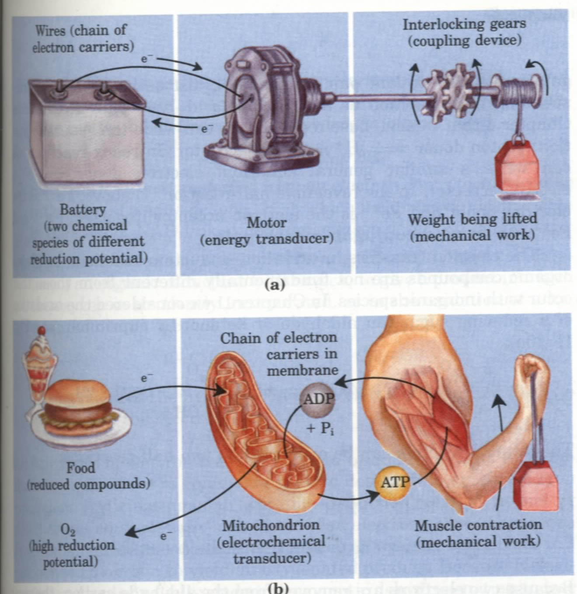
Energy is
“generated” via
electron flow
both in a battery
and in a cell!

Slide 42
Notes:
本章解决两个问题：1.生命需要能量，能量能不能定量？如何定量？
2.产生ATP的关键环节，电子传递链？

Slide 43
6. A few universal carriers (as coenzymes) collect electrons from the oxidation of various substrates

Slide 44
NAD⁺, NADP⁺, FAD are the few commonly used such reversible electron carriers.
NAD and NADP are dinucleotides able to accept/donate a hydride ion (:H⁻ , =H⁺ +2e⁻) for each round of reduction/oxidation.
Notes:
Reduction of NAD⁺ and NADP⁺ can be easily followed by spectroscopy (at 340 nm).
hydride ion 英 [ˈhaidraid ˈaɪən] 美 [ˈhaɪˌdraɪd ˈaɪən] [词典] 氢阴离子，带一对电子的质子

Slide 45
In each specific NAD- or NADP-containing dehydrogenase, the hydride ion is added/taken stereospecifically from one side (A or B) of the nicotinamide (烟碱) ring.
FAD is able to accept/donate one or two electrons (as hydrogen atom), with absorption maximum shifts from 570 nm to 450nm.
NAD and NADP can easily diffuse out of the enzymes, but FMN and FAD are tightly bound to the enzymes.
Notes:
nicotinamide 英 [nɪkə'tɪnəmaɪd] 美 [ˌnɪkəˌtɪnəˌmaɪd] n. 烟碱; 维生素PP; 维生素B5

Slide 46
They serve as cofactors of various enzymes catalyzing the oxidation of nutrients.
NADH and FADH₂ will be further oxidized via the respiratory chain on the inner membrane of mitochondria or plasma membrane of bacteria for energy generation (transduction).
Notes:
ADP is commonly present all these universal electron carriers (as well as in Coenzyme A and ATP), suggesting that RNA catalyzed these reactions in the early stages of life.

Slide 47
Nicotinamide is derived From niacin(B5)
Notes:
烟酰胺腺嘌呤二核苷酸(或尼克酰胺腺嘌呤二核苷酸或辅酶Ⅰ)
NADPH 是一种辅酶，叫还原型辅酶Ⅱ

Slide 48
FMN (Flavin
MonoNucleotide)
FAD (Flavin Adenine
Dinucleotide)
Notes:
isoalloxazine英 [aɪsəʊə'lɒksəzi:n] 美 [ˌaɪsoʊr'lɒksəˌzɪn] n.异咯嗪

Slide 49
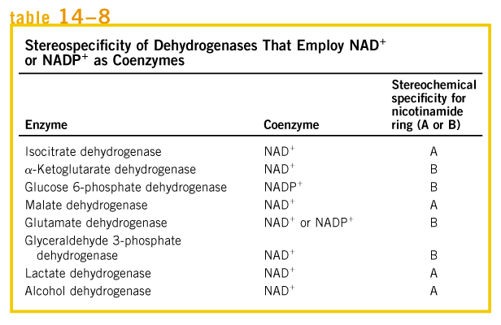
Notes:
Glutamate 谷氨酸

Slide 50
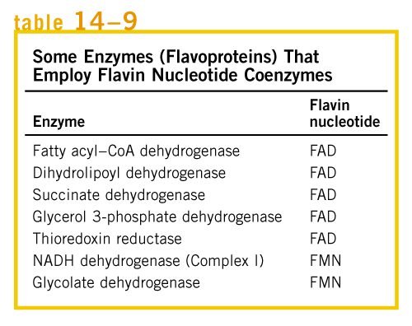
Notes:
glycolate 英 ['glaɪkəʊleɪt] 美 ['glaɪkoʊleɪt]
n. 乙醇酸盐（或酯），羟乙酸盐（或酯）

Slide 51
7. Electrons of NADH and FADH2 are transferred to O₂ via many intermediate electron carriers on the way.

Slide 52
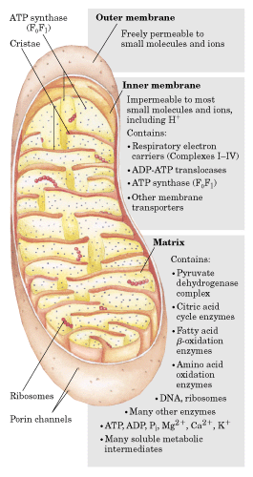

Slide 53
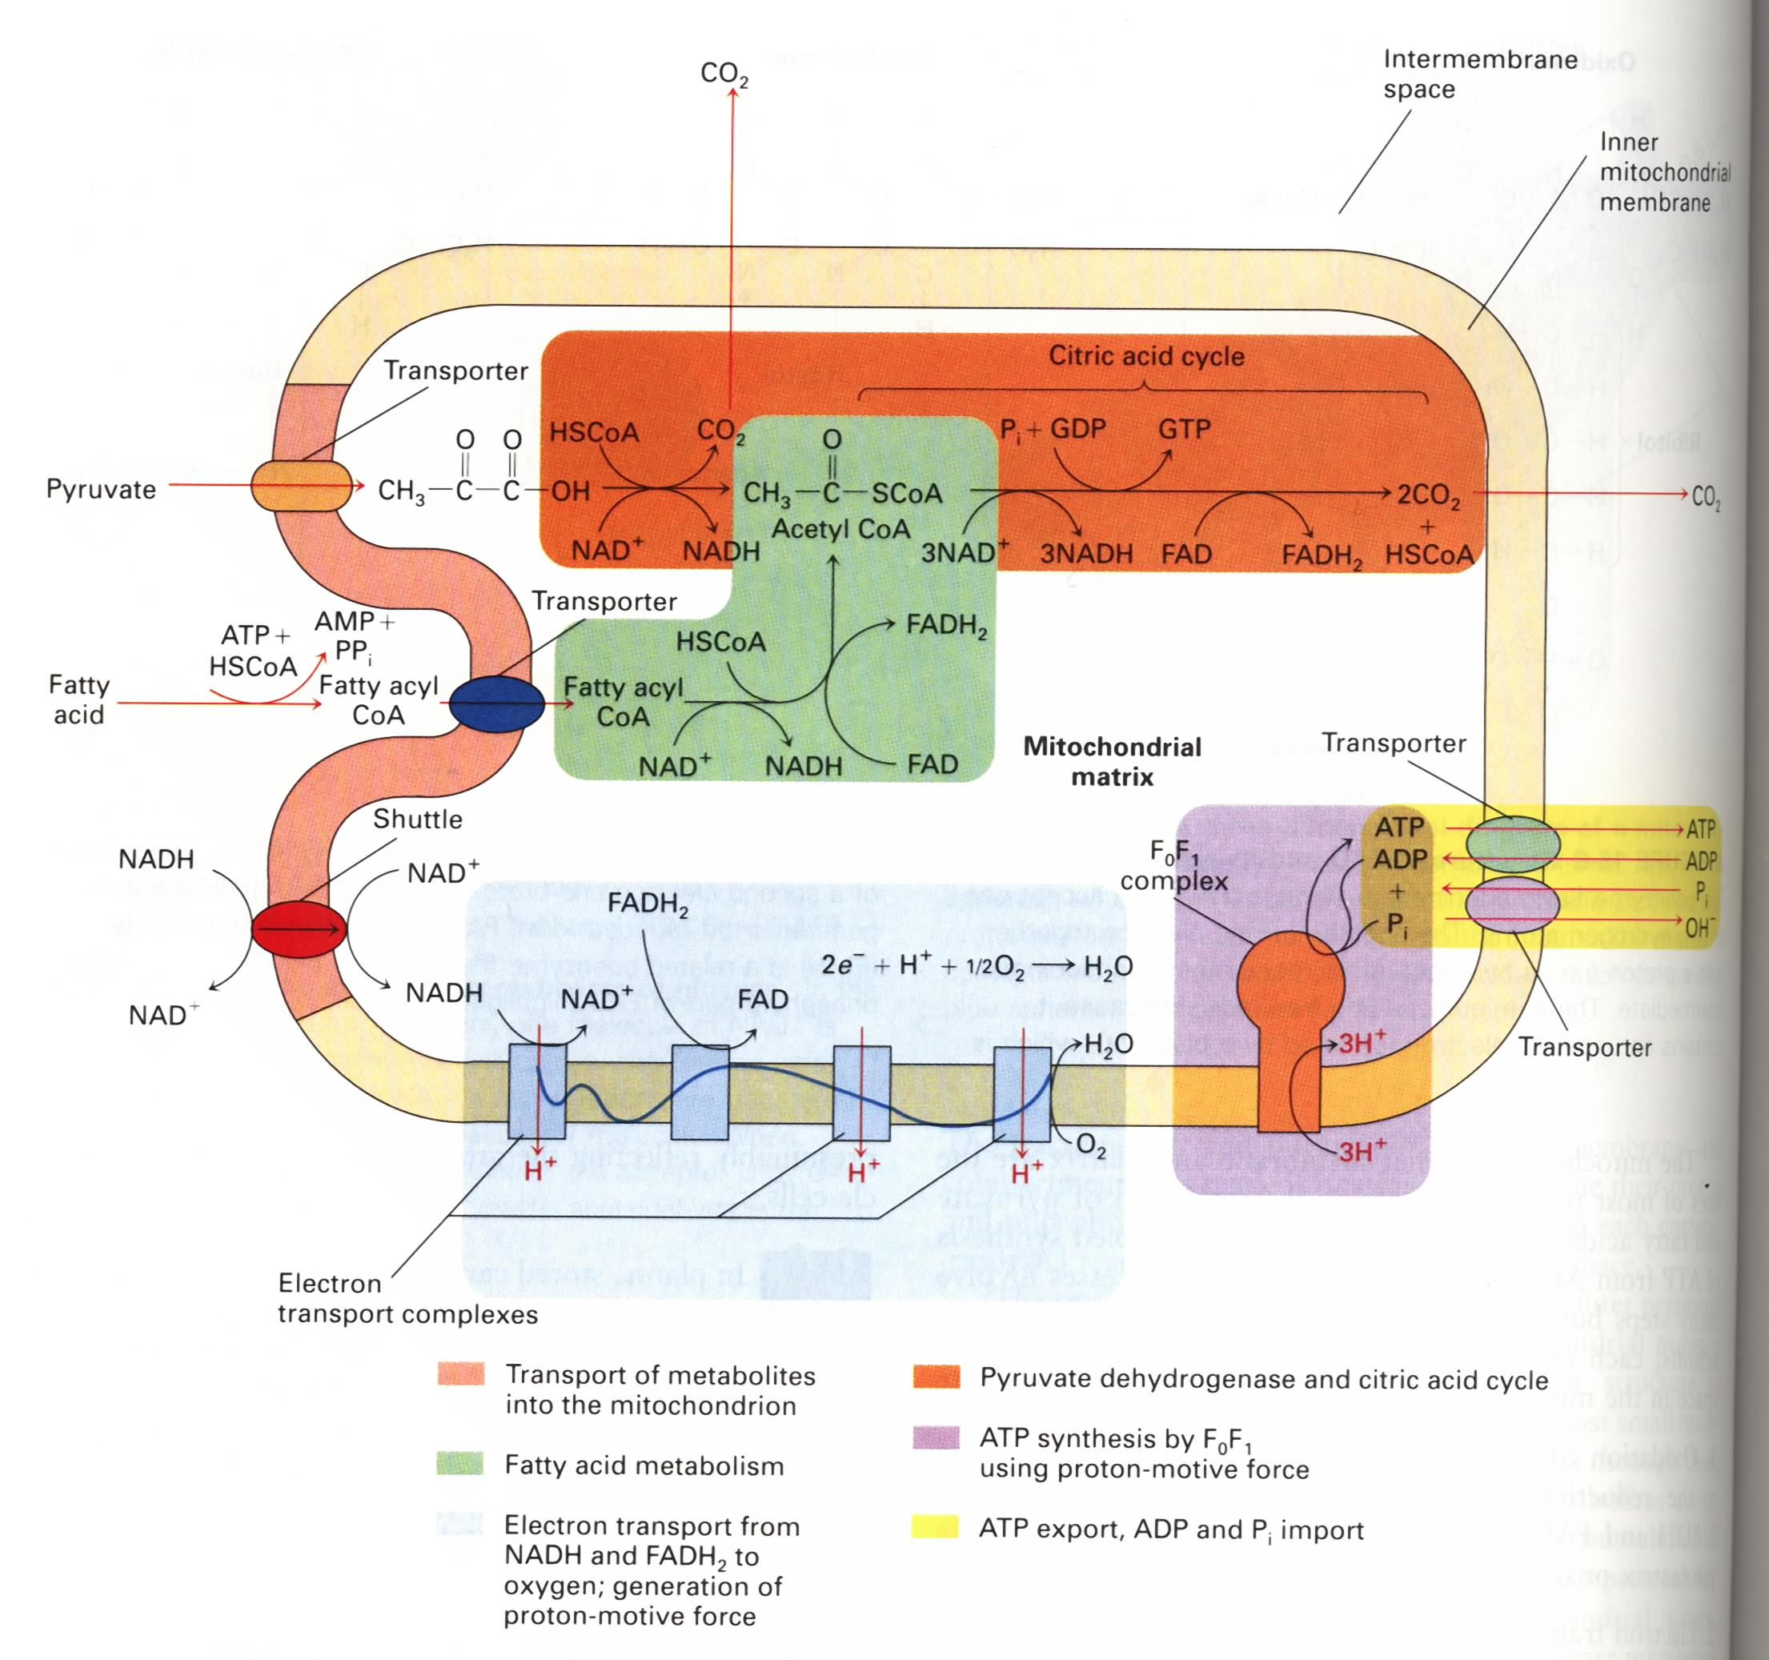
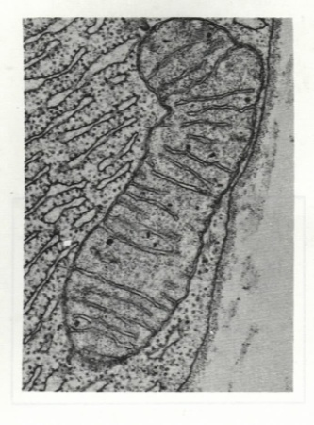
Oxidative phosphorylation
occurs on the inner membrane of mitochondria (cristae)
(or plasma membrane
In bacteria)

Slide 54
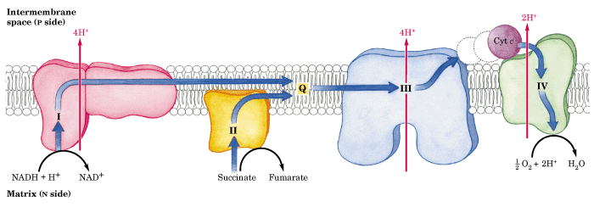

Slide 55
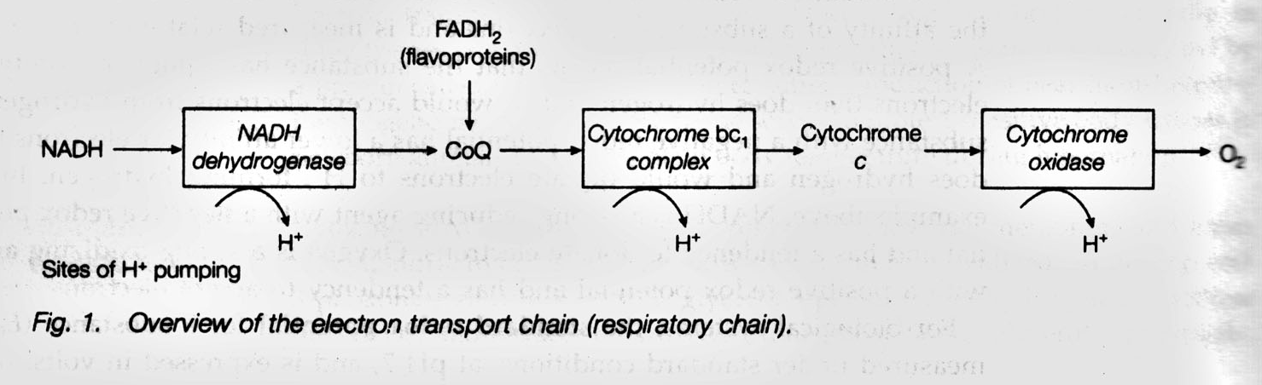
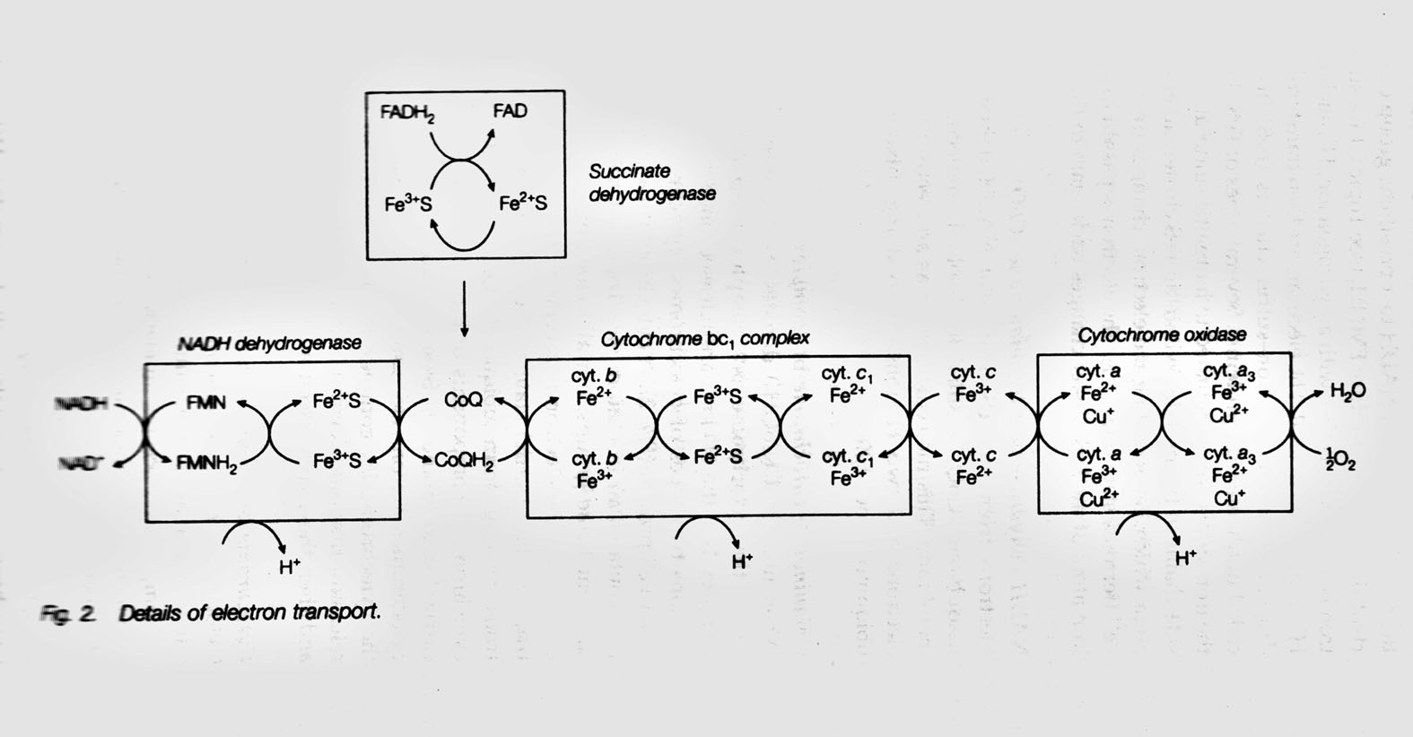

Slide 56
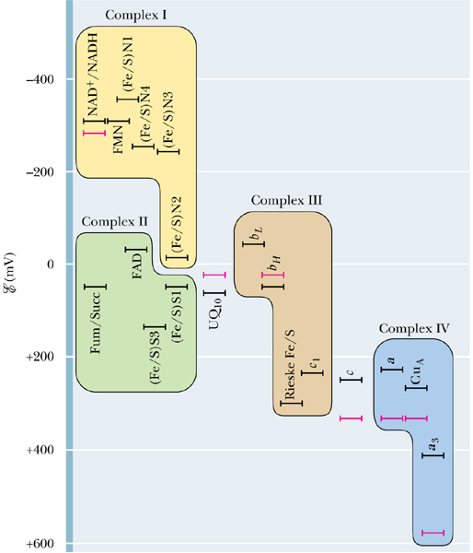

Slide 57
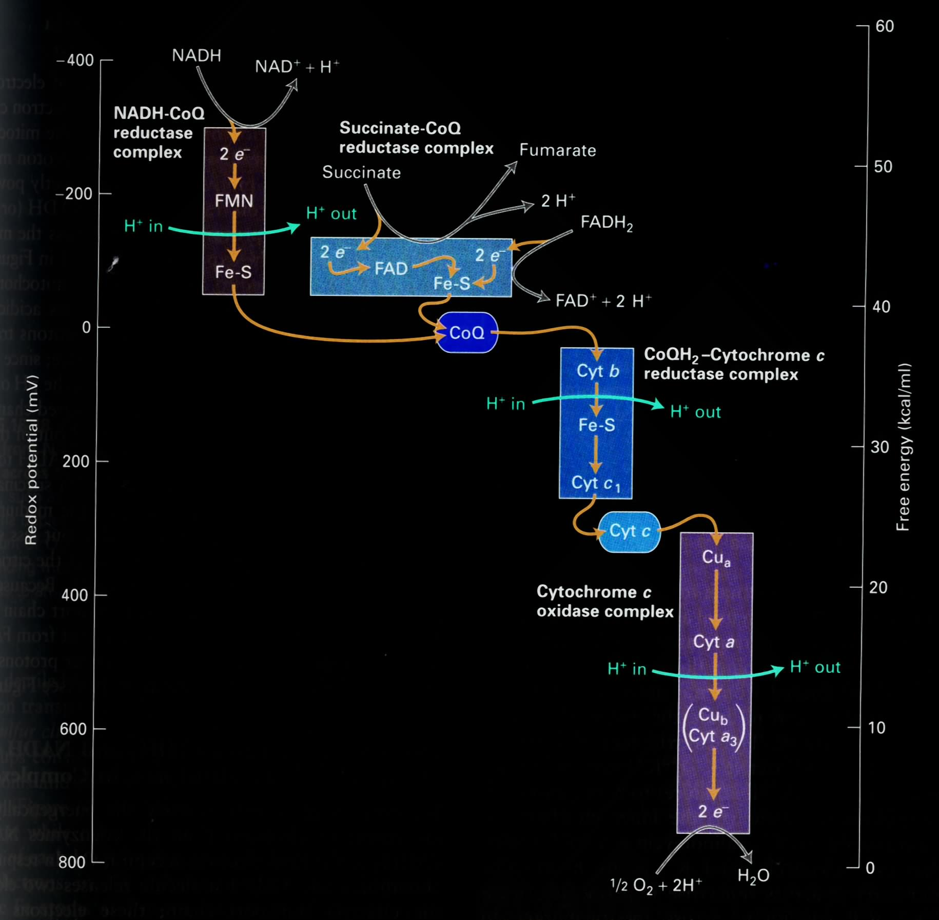
E`⁰ = -0.320 V
I
II
III
The respiratory chain
consists of 4 multi-
subunit complexes
and two mobile
e⁻ carriers.
IV
E`⁰ = 0.816 V

Slide 58
8. Various prosthetic groups act as intermediate electron carriers in the respiratory chain

Slide 59
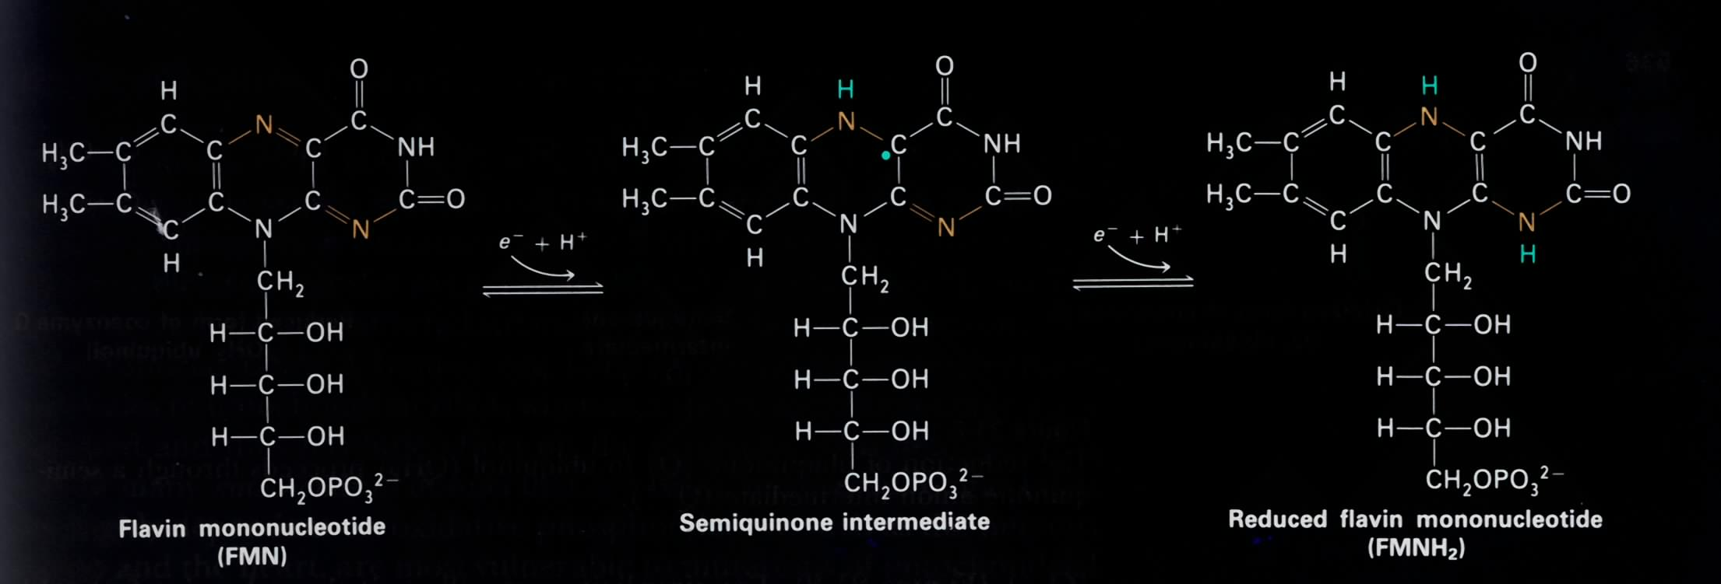
FMN and FAD can accept/donate one/two e⁻
Notes:
FMN哪里有核苷酸的成分？

Slide 60
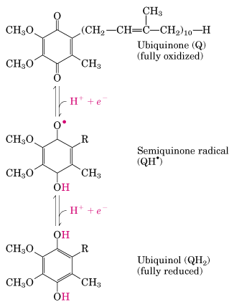
Q is a mobile one/two e⁻/H⁺ carrier
The only e⁻ carrier
not bound to a protein
Q/QH2 diffuses freely
in the lipid bilayer
Notes:
泛醌/ 泛醇
Isoprene

Slide 61
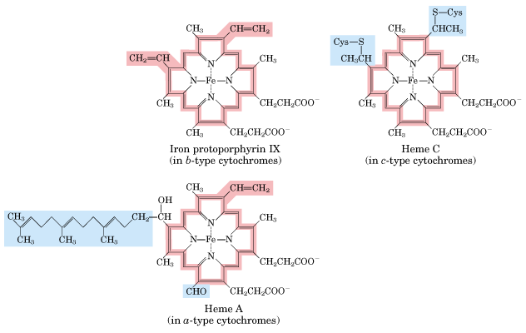
Three types of heme groups are found in cytochromes.
Notes:
protoporphyrin 英 [prəʊtə'pɔ:fɪrɪn] 美 [ˌproʊtoʊ'pɔ:fərɪn] n. 原卟啉
卟啉环合成的前体是：

Slide 62
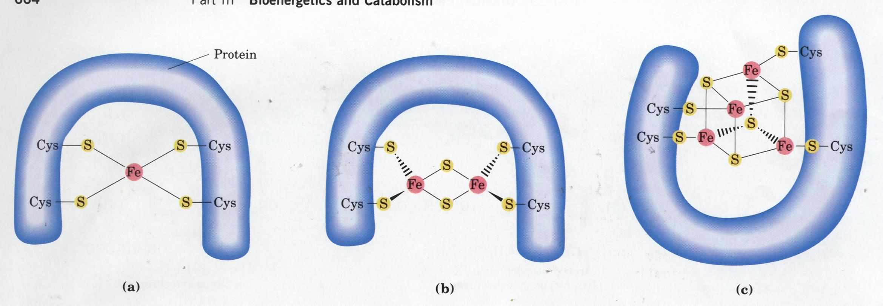
2Fe-2S
4Fe-4S
At least eight different types of iron-sulfur centers act in the respiratory chain: iron atoms cycle between Fe²⁺ (reduced) and Fe³⁺ (oxidized).

Slide 64
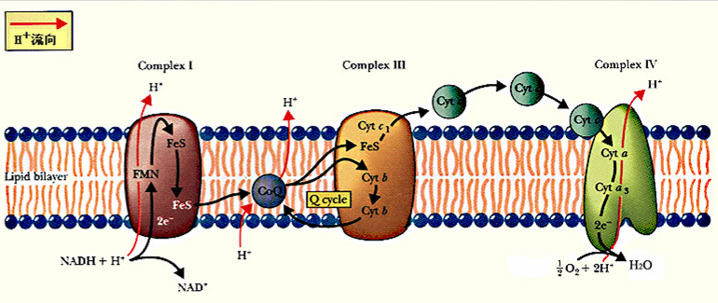

递氢体和递电子体交替排列

Slide 65
Complex I:
NADH enters at NADH dehydrogenase
(also NADH:ubiquinone oxidoreductase
or NADH-Q oxidoreductase).

Slide 66
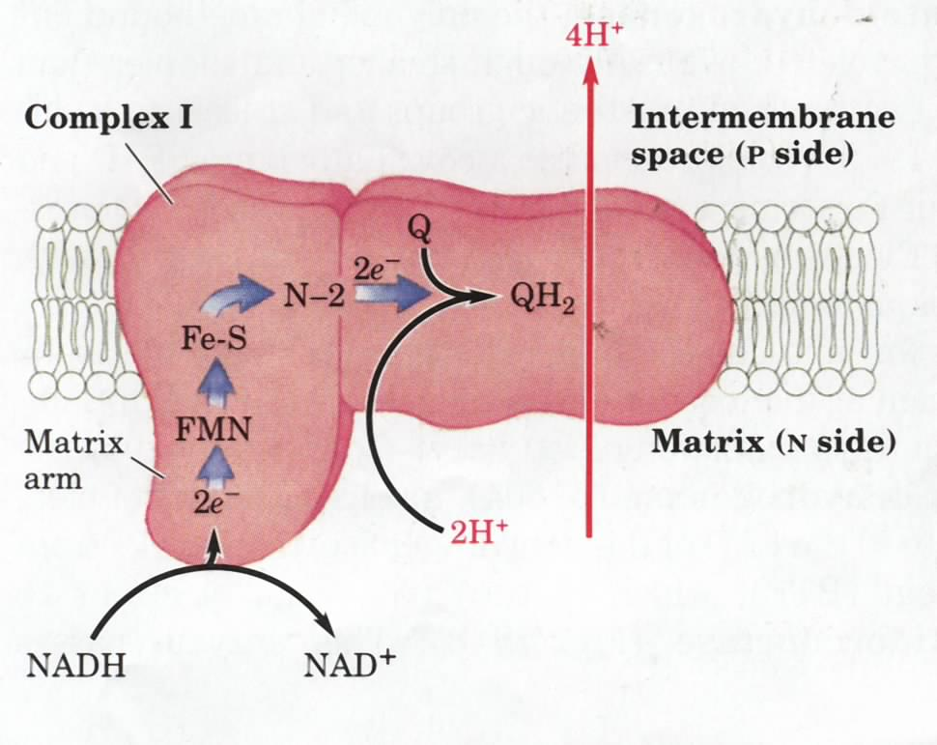
4th edition
Notes:
N-2是什么？

Slide 67
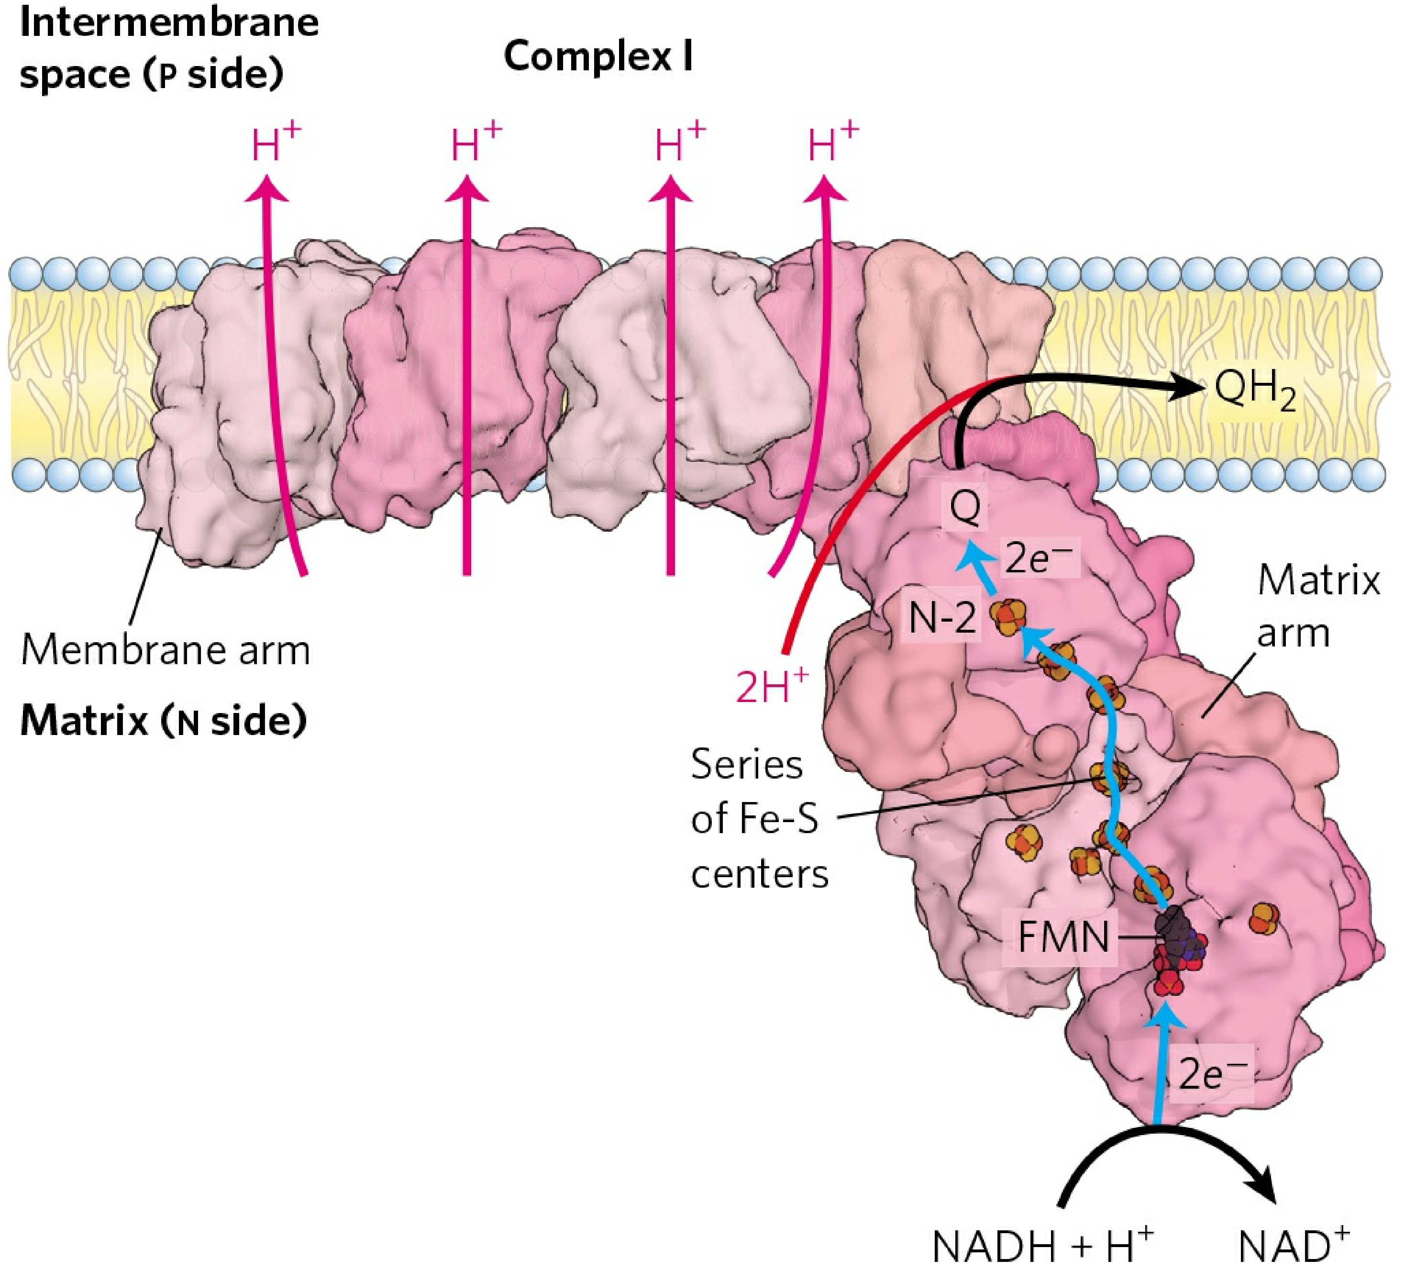
7th edition

Slide 68
(complex II) :
succinate Dehydrogenase
FADH₂ of flavoproteins also transfer their electrons to ubiquinone (Q), with no H⁺ pumped.
Notes:
泛醌（ubiquinone）
又称辅酶Q（CoQ），为一类脂溶性醌类化合物，带有由不同数目（6～10）异戊二烯单位组成的侧链.

Slide 69
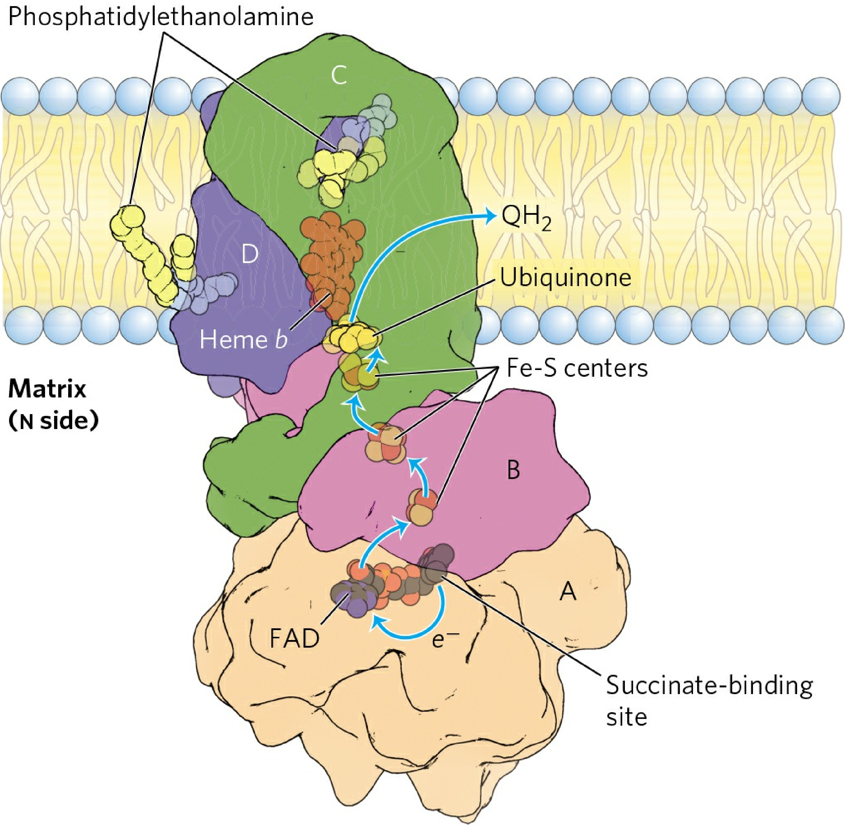
Structure of Complex II
(succinate dehydrogenase)
7th edition
Notes:
Structure of Complex II (succinate dehydrogenase)

Slide 70
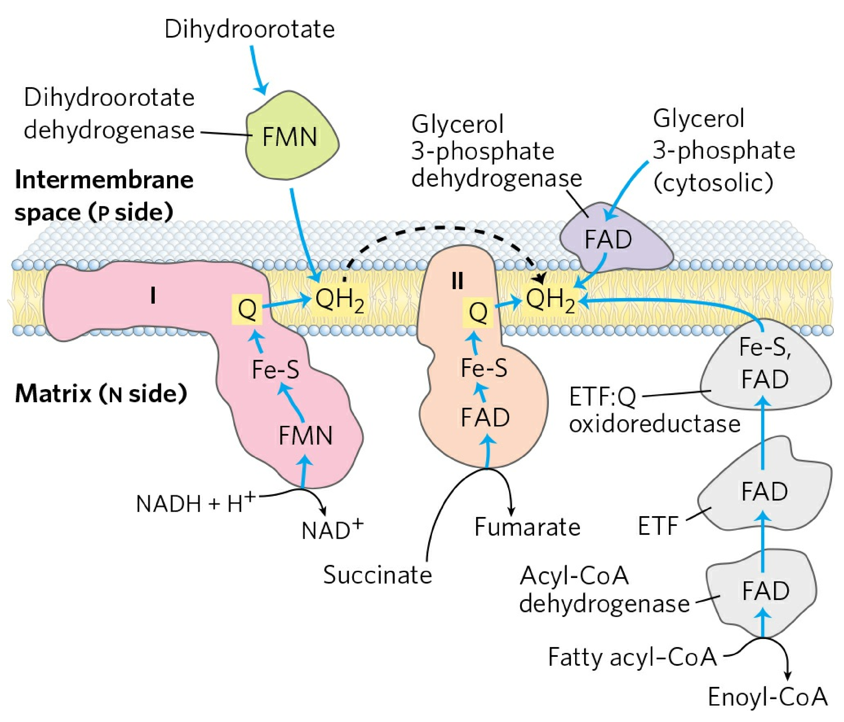
7th edition
Notes:
Dihydroorotate dehydrogenase, which acts in the synthesis of pyrimidines (see Fig. 22-38),
is also on the outside of the inner mitochondrial membrane and donates electrons to Q in the
respiratory chain. The reduced QH2 passes its electrons through Complex III and ultimately to O2.
Dihydroorotate dehydrogenase 该酶的辅酶为NADH, 为何此处标记FMN
目前网上查到的最新版为生物化学原理 第八版 Lehninger Principles of Biochemistry...

Slide 71
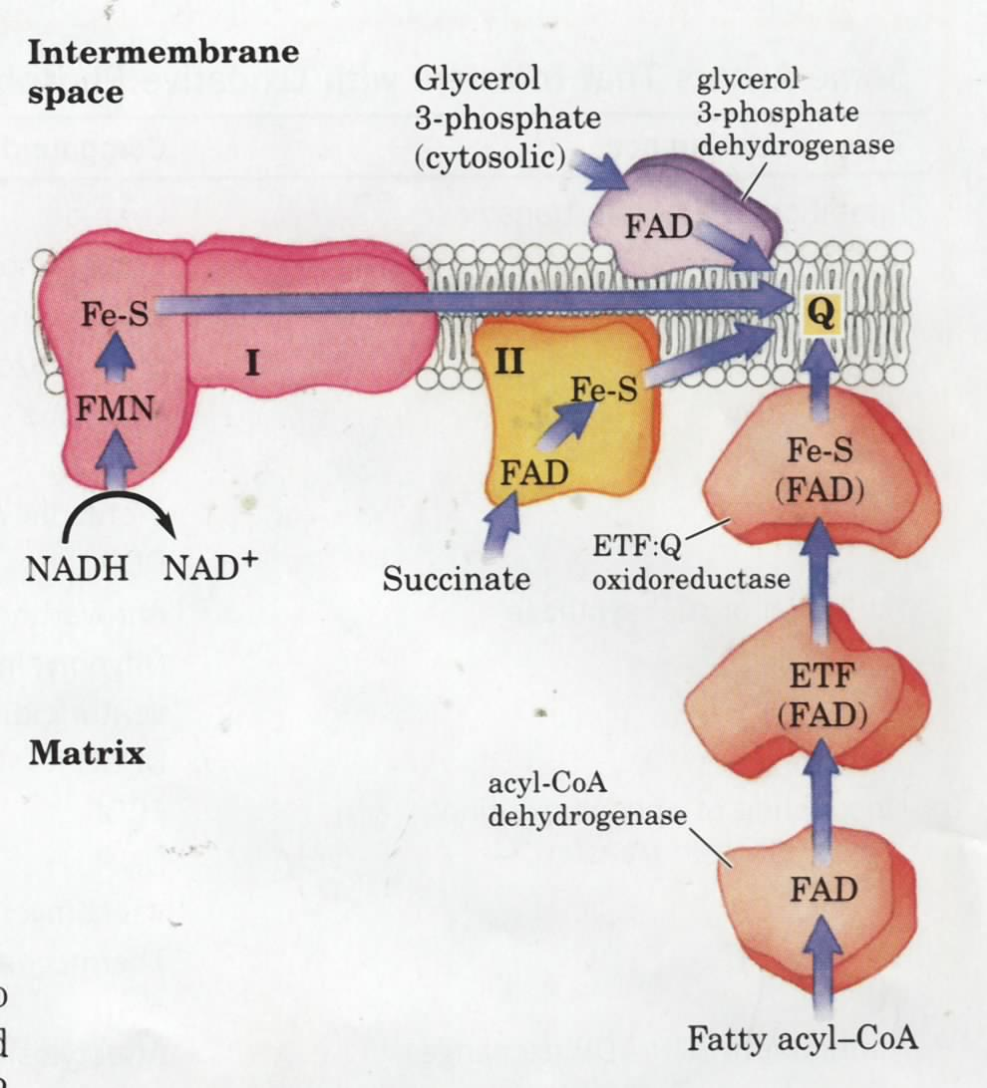
Notes:
脂肪酸β-氧化的反应途径 脂酰-CoA脱氢酶的作用 ETF: Electron transfer flavoprotein

Slide 72
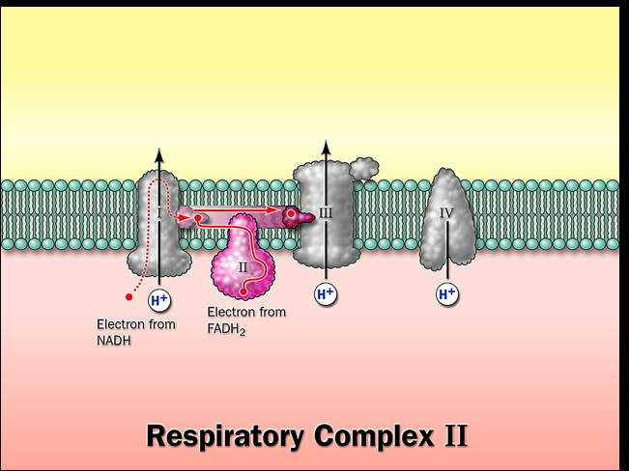

Slide 73
(Complex III)
Cytochrome bc₁ complex passes 2e⁻ from 1 QH₂ to 2 cytochrome c
e⁻ transferring & H⁺ pumping in Complex III via the Q cycle (for each 2 e⁻ transferred, 4H⁺ are released at the P side and 2H⁺ taken from the N side)

Slide 74
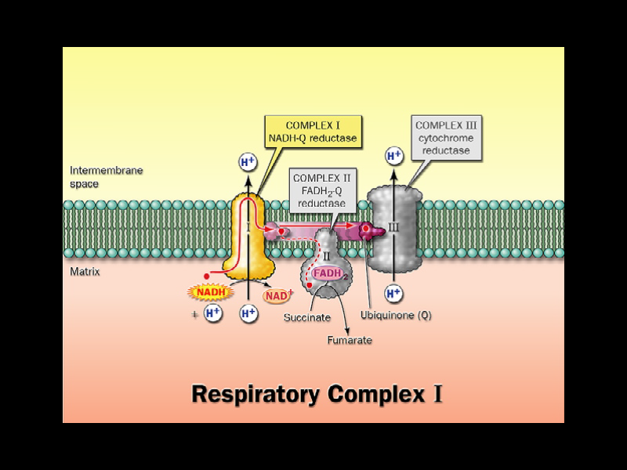

Slide 75
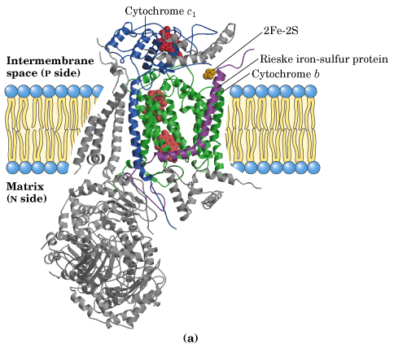

Slide 76
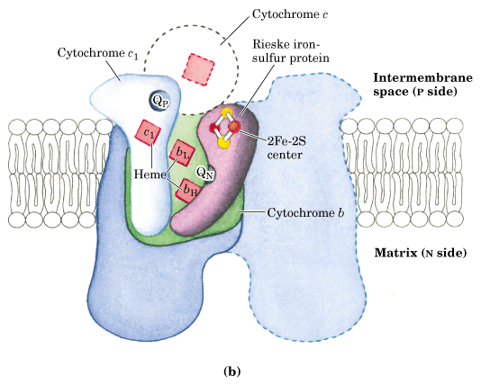

Slide 77

The Q
cycle
Q_{p}
The Q
cycle
Q_{p}
Q_{N}
Q_{N}
1st QH₂
2nd QH₂
A switch between 2e⁻
carrier (QH₂) and
1e⁻ carrier (Cyt c)

Slide 78


Slide 79
Complex IV :
Cytochrome c oxidase, the terminal
enzyme of the respiratory chain, contains
3 Cu and 2 heme A groups as electron carriers

Slide 80

Cu_{A}-CuA
Cu_{B}
Copper center A
Heme a
Cu_{A}
Heme a₃
Cu_{A}

Slide 81
~ 10 protons are pumped per NADH, and ~6 per FADH₂ oxidized via the respiratory chain.
Notes:
问题，递氢体是不是质子泵？

Slide 82

7th edition
7th edition

Slide 83

7th edition

Slide 84
磷氧比（P/O）
每消耗一个氧原子所形成的ATP数或每一对电子通过呼吸链传至O₂所产生 的 ATP分子数。
NADH呼吸链中P/O比为2.5
FADH₂呼吸链中P/O比为1.5

Slide 85
9. The order of the many electron carriers on the respiratory chain have been elucidated via various studies

Slide 86

Notes:
问题：为什么多次出现FeS中心？为什么此表中没有FeS中心？

Slide 87

Reduced
Reduced
Reduced
Studies with specific inhibitors help to reveal the orders of the e⁻ carriers
Notes:
一氧化碳中毒是含碳物质燃烧不完全时的产物经呼吸道吸入引起中毒。中毒机理是一氧化碳与血红蛋白的亲合力比氧与血红蛋白的亲合力高200～300倍，所以一氧化碳极易与血红蛋白结合，形成碳氧血红蛋白，使血红蛋白丧失携氧的能力和作用，造成组织窒息。对全身的组织细胞均有毒性作用，尤其对大脑皮质的影响最为严重。

Slide 88
NADH
电子传递抑制剂
杀粉蝶霉素A
鱼藤酮
FMN
复合物 I
安密妥
Fe-S
琥珀酸
FMN
Fe-S
CoQ
复合物 II
Cyt b
复合物 III
抗霉素A
Fe-S
Cyt c1
Cyt c
H₂S、 N₃
氰化物CN⁻
Cyt aa3
复合物 IV
CO
O2

Slide 89
10. Electron transfer to O₂ was found to be obligatorily coupled to ATP synthesis from ADP + P_{i} in isolated mitochondria
Notes:
obligatory 英 [əˈblɪgətri] 美 [əˈblɪgətɔ:ri] adj. 强制性的; 义务的; 必须的; 应尽的

Slide 90
11. How is oxidation of NADH/FADH₂ coupled to the phosphorylation of ADP?

Slide 91
The chemiosmotic model was proposed by Peter Mitchell in 1961 to explain the coupling of electron flow and ATP synthesis
The chemiosmotic model of Mitchell:
e⁻ flow and ATP synthesis are separate events, coupled via a transmembrane H⁺ gradient!
Notes:
化学渗透假说(chemiosmotic coupling hypothesis)

Slide 92

Notes:
alkaline 英 [ˈælkəlaɪn] 美 [ˈælkəlɪn, -ˌlaɪn] adj. 碱性的，碱的; 含碱的; n. 碱度，碱性

Slide 93

7th edition

Slide 94

化学渗透学说
化学渗透假说的要点：
a. 线粒体内膜的电子传递链是一个质子泵；
b. 在电子传递链中，电子由高能状态传递到低能状态时释放出来的能量，用于驱动膜内侧的H⁺迁移到膜外侧，线粒体内膜对H⁺是不通透的，这样，在膜的内侧与外侧就产生了跨膜质子梯度 (ΔpH) 和电位梯度（Δψ）；

Slide 95
c. 在膜内外势能差（ΔpH 和Δψ）的驱动下，膜外高能质子沿着一个特殊通道（ATP酶的组成部分），跨膜回到膜内侧。质子跨膜过程中释放的能量，直接驱动ADP和磷酸合成ATP。

Slide 96

化学渗透学说示意图
+ + + + + + + + +
氧化
线粒体内膜
_ _ _ _ _ _ _ _ _ _
磷酸化
2e⁻
NADH+H⁺
4H⁺
高质子浓度
4H⁺
4H⁺
ADP+Pi
ATP
2H⁺
H₂O
质子流
4H⁺

Slide 97




Slide 98
氧化磷酸化的解偶联和抑制
解偶联剂（uncoupler)
氧化磷酸化抑制剂
离子载体抑制剂(ionophore)

Slide 99

  1、解偶联剂（uncoupler）
使电子传递与ADP磷酸化分离，只抑制ATP的形成，而不抑制电子传递
[例1]2,4-二硝基苯酚（dinitrophenol,DNP）:酸性条件下为脂溶性物质，自由通过线粒体膜，将膜内H⁺带进基质,破坏了H⁺ 梯度.
外
内
线粒体内膜
NO₂
NO₂
NO₂
NO₂
H⁺
NO₂
NO₂
NO₂
NO₂
OH
O⁻
O⁻
OH
H⁺
Notes:
为什么2，4-二硝基苯酚不能用来做减肥药？
因为DNP是一种解偶联剂，是让身体内的ATP合成收到阻碍，这样身体就会自发分解脂肪和蛋白质获得能量来弥补ATP合成的不足，从而让体重减轻。但是过度分解会导致人死亡，有这样的案例，所以禁用了。你找个学过生物化学这门课的人问一下就懂了。
最新研究是耶鲁大学医学院的超级牛人(CNS发表的论文无数，年内发表论文高达30篇)，内分泌学家Gerald Shulman带领下完成的，最早在第一次世界大战期间，科学家发现法国军工厂工人接触高浓度2，4-二硝基苯酚后体重下降，少数人会中毒死亡。进一步研究发现，这种药物具有很好的减肥作用，1930年代被作为非处方减肥药物广泛使用，据说有至少10万美国人使用该药物减肥。后来发现这种药物副作用明显，导致许多食用者死亡，FDA禁止使用该药物。但现在仍有不少人使用这种东西减肥，而且不断有报道因大剂量使用致死的。由于这种物质是一种简单的线粒体膜质子漏药物，一直被科学家作为线粒体研究重要工具药。

Slide 100

proton gradient is
dissipated
Notes:
FCCP解偶联剂是线粒体氧化磷酸化解偶联剂，羰基-氰-对-三氟甲氧基本腙

Slide 101
  2、氧化磷酸化抑制剂
【作用】对电子传递和ADP的磷酸化均有抑制。
[例]寡霉素(Oligomycin):与ATP合酶的F₀部位结合，破坏H⁺回流，影响呼吸链质子泵的功能，抑制电子传递。

Slide 102


Slide 103
  3、离子载体抑制剂
【作用】与离子形成脂溶性物质，对ADP的磷酸化有抑制。
[例]缬氨霉素(Valinomycin)结合K＋，形成脂溶性复合物，于是K＋容易透过膜。
短杆菌肽结合K＋ 、Na＋， 破坏了膜两侧的电位梯度。

Slide 104
12. ATP synthase was first identified by dissociation and reconstitution studies
Notes:
F_{O}-F₁重组实验

Slide 105

Abundant knob-like protruding
structures were observed
on the matrix side of the inner
mitochondrial membrane
by EM (Racker in 1960).

Slide 106


Slide 107

化学渗透学说的实验证据（氧化磷酸化的重组实验）
破坏F1 –F0 因子
有电子传递作用；无ATP生成
F1-F0重组
电子传递与氧化磷酸化偶联

Slide 108

ATP synthase comprises a proton
channel (F_{o}) and an ATPase (F₁)
F₁: α₃β₃γδε.
F_{o}: ab₂c₁₀₋₁₂
Fo (o denoting oligomycin-sensitive)
Notes:
Fo（哦）不是0（零）
Fo (o denoting oligomycin-sensitive)

Slide 109


Slide 110
13. Electrons in NADH generated in cytosol is shuttled into mitochondria to enter the respiratory chain

Slide 111

Notes:
Glycerol 3-phosphate dehydrogenase

Slide 112

Glycerol-3-phosphate
shuttle system

Slide 113

Occurs in liver, kidney and heart
and is readily reversible (depending
on which side has a higher
NADH/NAD+ ratio.
Malate-aspartate
shuttle system

Slide 114
14. The pathways leading to ATP synthesis are coordinately regulated

Slide 115



Slide 116
Summary
Bioenergy is chemical energy, studied in terms of free energy and free energy change (ΔG ).
ATP acts as the free energy carrier in cells.
Bioenergy is mainly produced via stepwise electron flow (redox reactions) through a series of electron carriers having increasing levels of reduction potential (E).
Electrons released from the oxidation of nutrient fuels are initially channeled to a few universal electron carriers (including NADH and FADH₂).

Slide 117
Electrons collected in NADH and FADH₂ are released (at different entering points) and transported to O₂ via the respiratory chain, which consists of four multiprotein complexes (I, II, III, and IV) and two mobile electron carriers (ubiquinone and cytochrome c).
The order of the many electron carriers on the respiratory chain have been elucidated via various studies, including measurements of the standard reduction potential and effects of various respiratory chain inhibitors.

Slide 118
Electron transfer to O₂ was found to be coupled to ATP synthesis from ADP + Pi in isolated mitochondria.
The chemiosmotic theory explains the coupling of electron flow and ATP synthesis.
ATP synthase comprises a proton channel (F_{o}) and a ATPase (F₁).
Electrons in NADH generated in cytosol is shuttled into mitochondria to enter the respiratory chain.
The pathways leading to ATP sysnthesis is coordinately regulated.

Slide 119
END
Thank you

Slide 120

Reduced cytochromes
has three absorption
bands in the visible
wavelengths

Slide 121


Slide 123


Slide 124


Slide 125


Slide 126
It was widely believed that ATP synthesis occurs by chemical coupling
High energy intermediates similar to 1,3-bisphophoglycerate (which is used for substrate-level phosphorylation) was once proposed to be produced first from the electron flows on both the mitochondrial and chloroplast membranes.
Phophorylated protein intermediates (as formed in the action of phosphoglycerate mutase and phosphoglucomutase) were also hypothesized.
But neither were ever revealed despite intense efforts by many investigators over several decades.

